Slide 1
Pathways for Łódź You? Toastmasters Conference
26 August 2017
Ellen Hermens, DTM
Chief Pathways Ambassador, District 95
Franciszek Szych, DTM
Assistant Chief Pathways Ambassador, District 95
Notes:
Ellen Hermens, DTM – Chief Ambassador – person responsible for informing and implementing Pathways in the District.
Franciszek Szych, DTM – Assistant Chief Pathways Ambassador.
Pathways for Officers – presentation about Pathways for Club Officers

Slide 2
The electric light
did not come from
the continuous improvement
of Candles.
Oren Harari

Slide 3
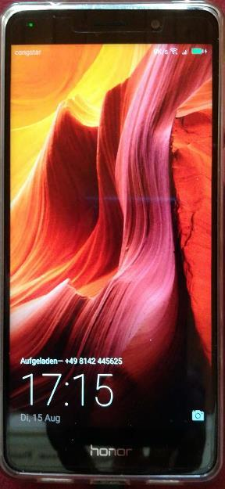
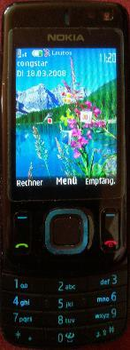

Slide 4
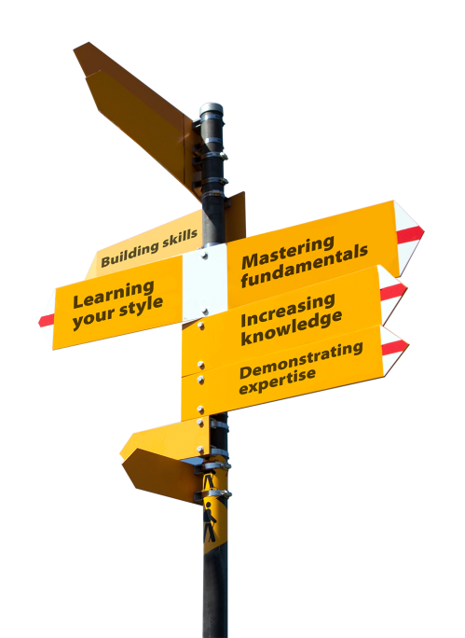
Agenda: + about PATHWAYS + when + how + what to do + questions

Slide 5
About Pathways
WHY Pathways?
< 10% CC, CL
not real life-relevant
choice
What’s new
10 = 280
survey and choice
online
Everything stays
Notes:
Why did Toastmasters wanted to improve education program?
Surveys gathered around the world shown that the current program is good, but lacking. Many modern communication situations are not presented in the
Second problem: very few members reach any education awards:
In 2010: <10% CC, <2% CL, <1% advanced awards.
In 2015: ~8% CC, ~5% CL.
The solutions are:
+ 10 paths to choose from, containing 280 competencies,
+ survey to help you choose the path best suited to you,
+ online content including examples, videos, tests,
+ many modern real-life projects.
Everything else stays: club meetings, speeches, roles, atmosphere, feedback.

Slide 6
Schedule - FlipChart

Slide 7
Rollout
New Program: Survey + Choice
Pathways || Current Program
More trainings for Officers
DCP = Pathways + current program
Notes:
When the Rollout starts, members will have a choice to start using Pathways. They can stay with the current program or do projects from both at the same time.
Every member can take a survey helping him choose a path. Every current member has access to 1 Pathways path for free (which can be changed within 3 months).
There will be more trainings and Pathways Guides will be available to answer all your questions.
After the Rollout clubs can gather points from 2 DCP programs – so it is easier to get more points.
How it looks in the first District to adopt Pathways? https://d57tm.org/pathways/

Slide 8
2 Programs in Parallel
How much effort?
Preparations for trainings & support
Recommendation: 1 VPE + 1 Assisting VPE
Notes:
How much effort? We don´t know yet
Preparations for and we do our best to:
Train all officers (in advance)
Support from the district (Pathways Guides)
Recommendation: 1 VPE + 1 Assisting VPE (Best Practice: Having 2 VPE in parallel for a year – each getting credits for half a year)
at least during rollout – better during whole transition period.

Slide 9
Example path
Presentation Mastery
Understanding Your Communication Style
Persuasive Speaking
Managing a Difficult
Audience
Prepare to Speak
Professionally
Effective Body Language
Understanding Vocal Variety
Question-and-Answer Session
Inspire Your Audience
Moderate a Panel Discussion

Slide 10
Example path
Dynamic Leadership
Understanding Your Leadership Style
Negotiate the Best Outcome
Manage Change
Lead in Any Situation
Understanding Your Communication Style
Connect with Your Audience
Manage Online Meetings
Focus on the Positive
Lessons Learned

Slide 11
What to do?
Don´t panic!
Read info
Get in touch: Ambassador / PWG
Ask questions
Prepare members
Ensure working member login
Find helpers
Enjoy the future
Notes:
So what can you do as an Officer to be ready for Pathways?
0. Don’t panic. We are preparing for this for 7 years now. And there is still quite some time left. It will be ok.
1. First, read basic information about Pathways.
2. Ask questions. Ask Ambassadors and Chief Ambassador. Not all of the questions can be answered yet, but we gather them and try to answer in FAQs e.g. on the District website.
See also: https://www.toastmasters.org/Education/Pathways/FAQ
3. Prepare your members by giving them basic knowledge about Pathways and letting them know you will be prepared when the time comes.
4. Find a helping hand (for VPE) to get the latest information about Pathways and to manage the transition.
5. Be optimistic – the new program means a bit more work initially, but also more possibilities for our members to develop.

Slide 12
Questions? Come to us...

